Slide 1

Customer Shopping Behavior Analysis
Uncovering insights from 3,900 purchases to guide strategic business decisions through data-driven analysis of spending patterns, customer segments, and product preferences.

Slide 2

Dataset Overview
3,900
18
50
Total Purchases
Data Points
Locations
Comprehensive transaction records analyzed
Features covering demographics and behavior
Geographic diversity across customer base
25
Products
Unique items across four categories

Slide 3

Data Preparation & Engineering
Python Analysis
Key Statistics
Loaded dataset using pandas
Average Purchase: $59.76
Imputed 37 missing Review Rating values using category medians
Age Range: 18-70 years
Average Rating: 3.75/5.0
Standardized columns to snake case
Previous Purchases: 1-50 per customer
Created age_group and purchase_frequency_days features
Integrated with PostgreSQL for SQL analysis

Slide 4

Revenue Insights
Gender Revenue Gap
Shipping Preferences
Male customers generated $157,890 vs. Female customers at $75,191 — a significant 2:1 revenue ratio
Express shipping users spend $60.48 on average vs. $58.46 for Standard — premium service attracts higher spenders
Subscription Impact
1,053 subscribers contribute $62,645 total revenue with $59.49 average spend per transaction

Slide 5
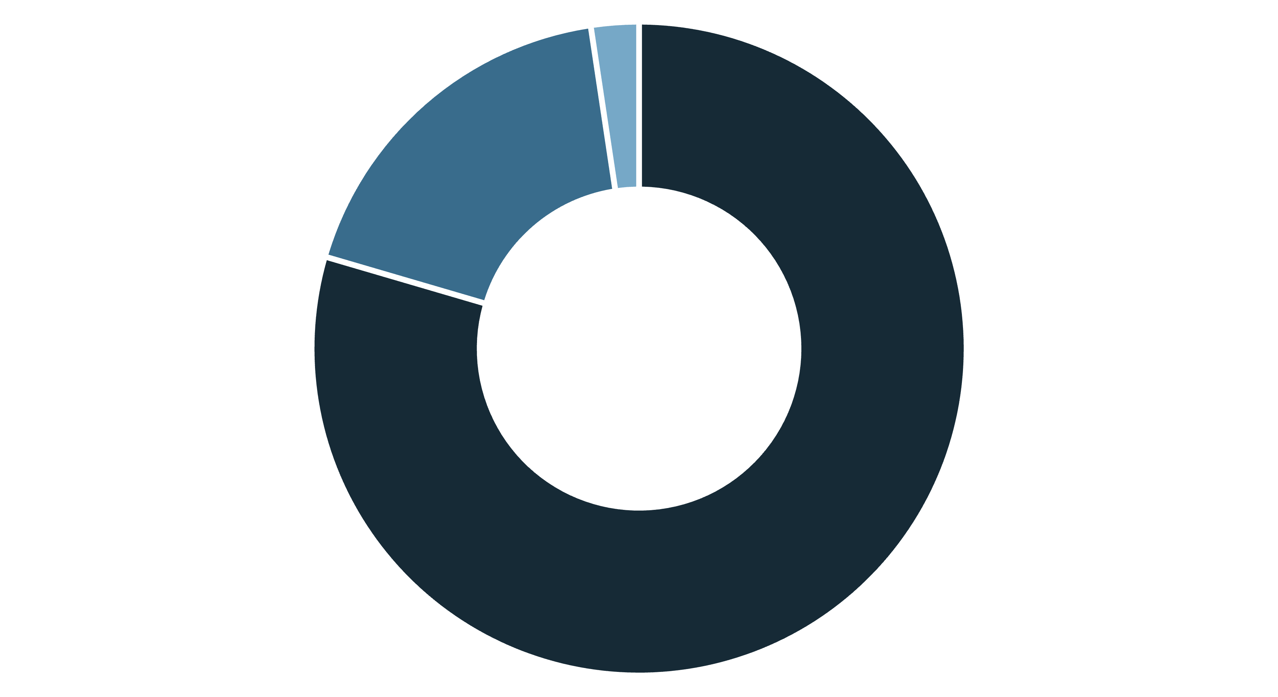
Customer Segmentation
Loyal
Returning
New
Loyal customers dominate at 80% of the base, while only 2% are new customers. This presents both an opportunity and a challenge: strong retention but limited acquisition.

Slide 6
Top-Performing Products
Gloves
1
Highest average rating: 3.86/5.0
Sandals
2
Second highest rating: 3.84/5.0
Boots
3
Strong performance: 3.82/5.0
Hat
4
Consistent quality: 3.80/5.0
Skirt
5
Top five rating: 3.78/5.0

Slide 7

Discount Strategy Analysis
High-Value Discount Users
839 customers used discounts but still spent above the $59.76 average — proving discounts don't always mean lower revenue.
Discount-Dependent Products
Hat: 50% discount rate
Sneakers: 49.66%
Coat: 49.07%
Sweater: 48.17%
Pants: 47.37%

Slide 8
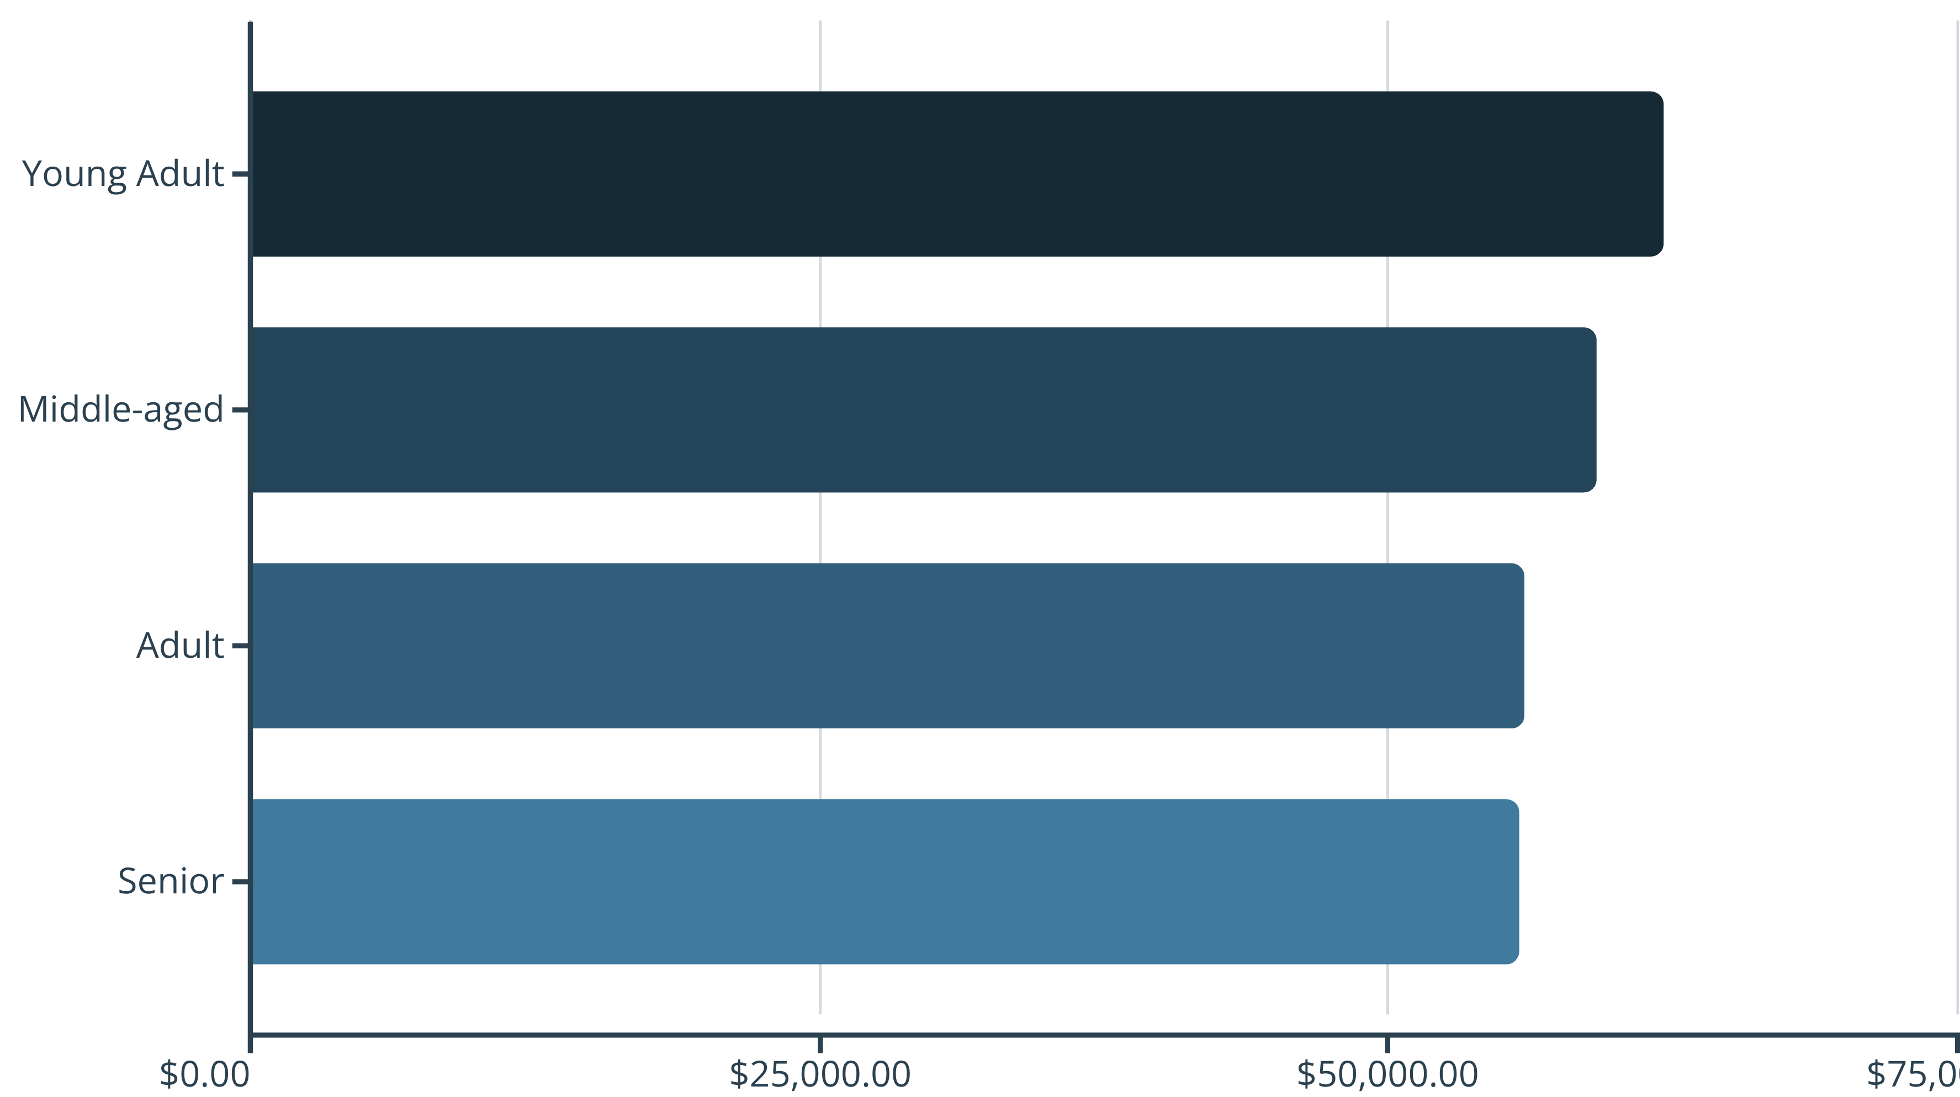
Age Group Revenue Distribution
Young Adults lead revenue generation, but all age groups contribute relatively evenly — suggesting broad market appeal across demographics.

Slide 9



Dashboard Highlights
27%
80%
68%
Subscription Rate
Loyal Customers
Male Customers
Of total customer base
Strong retention foundation
Dominant demographic
Interactive Power BI dashboard enables real-time filtering by subscription status, gender, category, and shipping type for deeper insights.

Slide 10





Strategic Recommendations
Boost Subscriptions
Promote exclusive benefits to convert the 73% non-subscriber base
Loyalty Programs
Reward repeat buyers to strengthen the 80% loyal segment
Optimize Discounts
Balance promotional sales with margin control on high-discount products
Highlight Top Products
Feature high-rated items like Gloves and Sandals in marketing campaigns
Targeted Marketing
Focus on Young Adults and express-shipping users for maximum ROI

